Slide 1
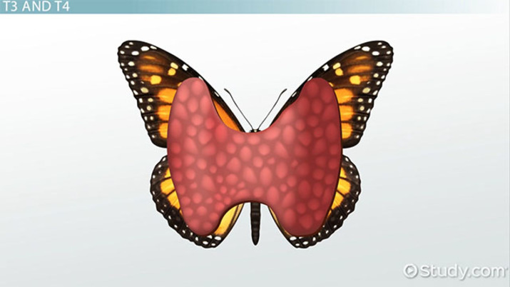
Hyperthyroidism and hypothyroidism
By Maher Abdul Ameer

Slide 3
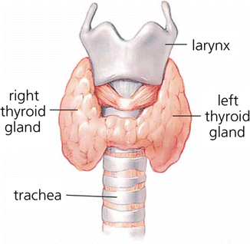
Thyroid gland
is a butterfly-shaped gland located at the front of the neck. It produces tetraiodothyronine (T4) and triiodothyronine (T3), which are two primary hormones that control how the cells use energy. The thyroid gland regulates metabolism through the release of these hormones.

Slide 4
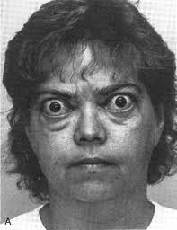
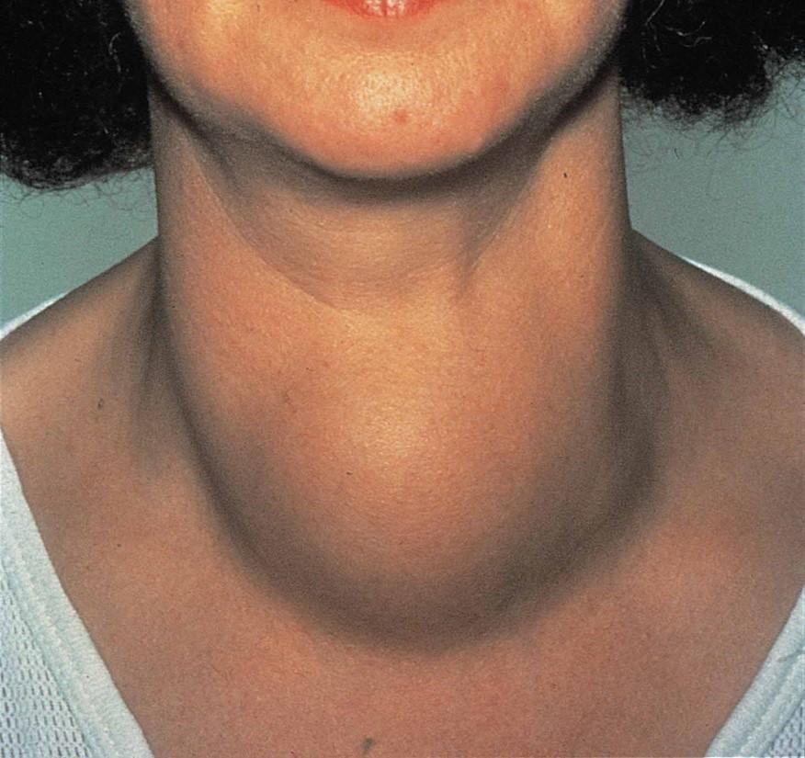
Hyperthyroidism

Slide 5
Hyperthyroidism
Hyperthyroidism is the condition that occurs due to excessive production of thyroid hormones by the thyroid gland.
Hyperthyroidism is a hyperthyroid state resulting from hypersecretion of thyroid hormones (T3 and T4).
Hyperthyroidism is characterized by an increased rate of body metabolism.

Slide 6
Epidemiology
100-200 cases per 100,000 every year, internationally.
Significantly higher incidence in women, 7:1 ratio
Most common amongst young women, but can occur at any age. Most seen between the ages of 20-40

Slide 7
Causes
Most common cause of hyperthyroidism Graves’ disease and an autoimmune disorder.
other causes of hyperthyroidism include:
Excess iodine, a key ingredient in T4 and T3
Thyroiditis, or inflammation of the thyroid, which causes T4 and T3 to leak out of the gland
Benign tumors of the thyroid or pituitary gland
Large amounts of tetraiodothyronine(T4) taken through dietary supplements or medication

Slide 8
Sings and symptoms
Enlarged thyroid gland (goiter)
Palpitations, cardiac dysrhythmias,
such as tachycardia or atrial fibrillation
Protruding eyeballs (exophthalmos)
Hypertension
Heat intolerance
Diaphoresis
Weight loss
Diarrhea
Smooth, soft skin and hair
Nervousness and fine tremors of hands
Personality changes
Irritability and agitation
Oligomenorrhea (Irregular menstrual periods in women)

Slide 9
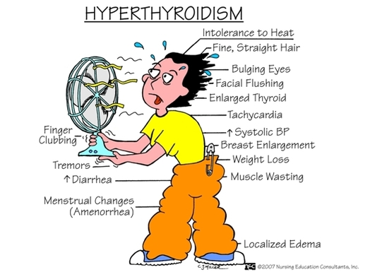

Slide 10
Diagnostic test
Thyroid-stimulating hormone (TSH) assay reveals a decrease in result (normal TSH: 0.5–1.5 mU/L).
Elevated Thyroxine (T4) radioimmunoassay (normal values: 5.0–12.0 μg/dL).
Elevated Tri-iodothyronine (T3) radioimmunoassay (normal values: 80–230 ng/dL).
Other Tests: 24-hr radioactive iodine uptake; thyroid autoantibodies; antithyroglobulin; electrocardiogram (ECG)
Ultrasound
CT or MRI scans

Slide 11
Complications
Thyroid crisis (storm), also called thyrotoxicosis.
Heart-related complications including:
Rapid heart rate
Congestive heart failure
Atrial fibrillation
Surgery-related complications, including:
Scarring of the neck
Hoarseness due to nerve damage to the voice box
Low calcium level due to damage to the parathyroid glands (located near the thyroid gland)

Slide 12
Medical Management
Treatment is directed toward reducing thyroid hyperactivity for symptomatic relief and removing the cause of complications.
Three forms of treatment are available:
Irradiation involving the administration of (131I) or (123I) for destructive effects on the thyroid gland.
Pharmacotherapy with antithyroid medications.
Surgery with the removal of most of the thyroid gland.

Slide 13
Radioactive Iodine (131I)
131I is given to destroy the overactive thyroid cells (most common treatment in the elderly).
131I is contraindicated in pregnancy and nursing mothers because radioiodine crosses the placenta and is secreated in breast milk.

Slide 14
Pharmacotherapy
The objective of pharmacotherapy is to inhibit hormone synthesis or release and reduce the amount of thyroid tissue.
The most commonly used medications are propylthiouracil (Propacil, PTU) and methimazole (Tapazole) until patient is euthyroid.
Maintenance dose is establish, followed by gradual withdrawal of the medication over the next several months.
Antithyroid drugs are contraindicated in late pregnancy because of a risk for goiter and cretinism in the fetus.

Slide 15
Surgery
Surgical treatment with thyroidectomy is no longer the preferred choice of therapy for Graves’ disease but is an alternative therapeutic approach in some situations. In particular, it is used for patients who cannot tolerate antithyroid drugs, have significant ophthalmopathy, have large goiters, or cannot undergo radioiodine therapy.

Slide 16
Nursing diagnosis
Imbalanced nutrition, less than body requirements, related to exaggerated metabolic rate, excessive appetite, and increased GI activity.
Ineffective coping related to irritability, hyperexcitability, apprehension, and emotional instability
Low self-esteem related to changes in appearance, excessive appetite, and weight loss
Altered body temperature
CollaborativeProblems/Potential Complications

Slide 17
Nursing management
Provide adequate rest.
Administer sedatives as prescribed.
Provide a cool and quiet environment.
Obtain weight daily.
Provide a high-calorie diet.
Administer antithyroid medications (propylthiouracil [PTU] that block thyroid synthesis, as prescribed.
Administer iodine preparations that inhibit the release of thyroid hormone as prescribed.
Administer propranolol (Inderal) for tachycardia as prescribed.
Prepare the client for radioactive iodine therapy, as prescribed, to destroy thyroid cells.
Prepare the client for thyroidectomy if prescribed.

Slide 18
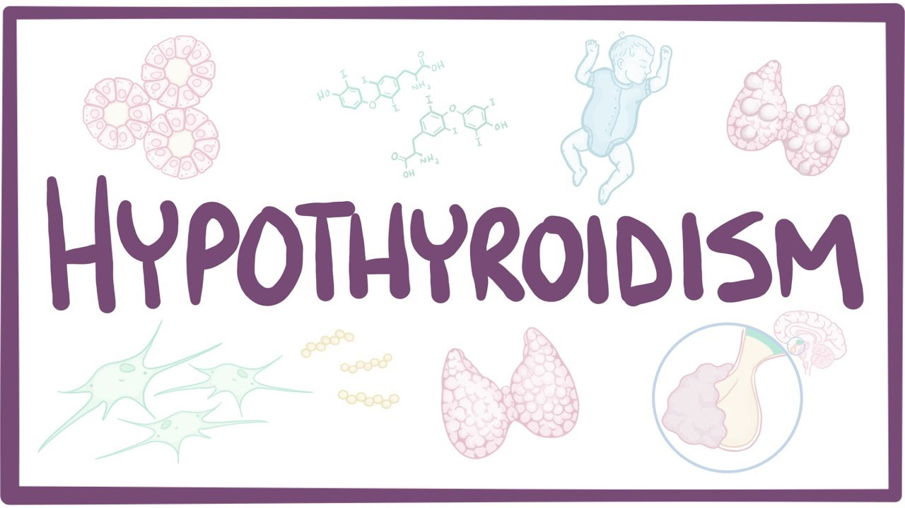

Slide 19
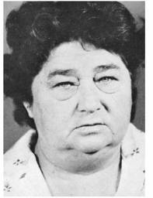
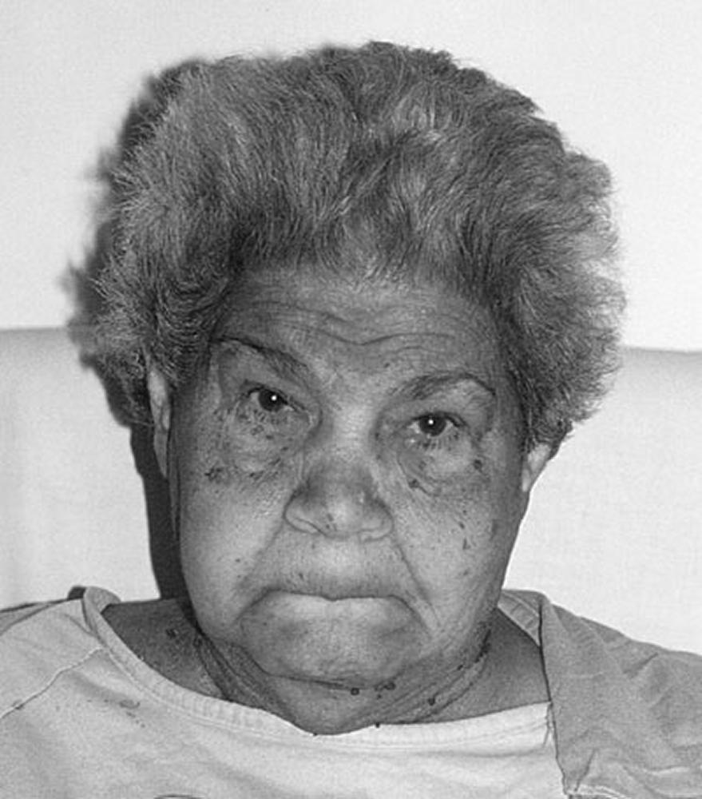
Hypothyroidism
Hypothyroidism(underactive thyroid): is a condition in which the thyroid gland is not able to produce enough thyroid hormone.

Slide 20
Causes of Hypothyroidism
Autoimmune disease: The most common cause of hypothyroidism is an autoimmune disorder known as Hashimoto's thyroiditis.
Over-response to hyperthyroidism treatment: People who produce too much thyroid hormone (hyperthyroidism) are often treated with radioactive iodine or anti-thyroid medications.
Thyroid surgery: Removing all or a large portion of thyroid gland can diminish or halt hormone production.
Radiation therapy: Radiation used to treat cancers of the head and neck can affect thyroid gland and may lead to hypothyroidism.
Medications: A number of medications can contribute to hypothyroidism. One such medication is lithium, which is used to treat certain psychiatric disorders.

Slide 21
Symptoms of Hypothyroidism
Fatigue
Weakness
Weight gain or increased difficulty losing weight
Coarse, dry hair
Dry, rough pale skin
Hair loss
Cold intolerance
Muscle cramps and frequent muscle aches
Constipation
Depression
Irritability
Memory loss
Abnormal menstrual cycles
Decreased libido

Slide 22
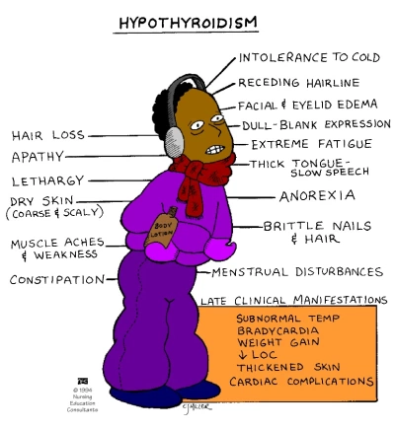

Slide 23
Risk factors
Woman.
Age older than 60y.
Family history of thyroid disease.
Autoimmune disease, such as type 1 diabetes or celiac disease.
Who treated with radioactive iodine or anti-thyroid medications.
Received radiation to the neck or upper chest.
Thyroid surgery (partial thyroidectomy).

Slide 24
Assessment and Diagnostic Findings
Physical examination: The thyroid gland is inspected and palpated routinely in all patients.
Serum thyroid-stimulating tests: Measurement of the serum TSH concentration is the single best screening test of thyroid function because of its high sensitivity.
Serum T3 and T4: Measurement of total T3 or T4 includes protein-bound and free hormone levels that occur in response to TSH secretion.
Thyroid antibodies: Results of testing by immunoassay techniques for antithyroid antibodies are positive in Hashimoto’s thyroiditis (100%).

Slide 25
Complications
Hypothyroidism can be a life-threatening disease if left unchecked.
Myxedema coma: This is the decompensated state of severe hypothyroidism in which the patient is hypothermic and unconscious.

Slide 26
Medical Management
The primary objective in the management of hypothyroidism is to restore a normal metabolic state by replacing the missing hormone.
Pharmacologic therapy: Synthetic levothyroxine is the preferred preparation for treating hypothyroidism and suppressing nontoxic goiters.
Supportive therapy:
Oxygen saturation levels should be monitored.
Fluids should be administered cautiously.
Application of external heat must be avoided.
Oral thyroid hormone therapy should be continued.

Slide 27
Nursing diagnosis
Decreased cardiac output related to bradycardia and decreased stroke volume
Fatigue related to impaired metabolic state.
Deficient Knowledge related to Lack of exposure to hypothyroidism, and new disease process.

Slide 28
Nursing management
promote rest and exercise as tolerated.
Provide extra layer of clothing or extra blanket.
Discourage and avoid the use of external heat source.
Monitor patient’s body temperature.
Encourage increased fluid intake within the limits of fluid restriction.
Provide foods high in fiber.
Monitor respiratory depth, rate, pattern, pulse oximetry, and ABG.
Encourage deep breathing, coughing, and use of incentive spirometry.
Orient patient to time, place, date, and events

